Slide 1
INTRODUCTION TO FINANCIAL ACCOUNTING

Slide 2
DEFINITIONS OF FINANCIAL ACCOUNTING
According to Smith and Ashburne,
Accounting is the science of recording and classifying business transactions and events, primarily of financial character and art of making significant summaries, analysis and interpretations of those transactions and events and communicating the results to persons who must make decisions or form judgements.
According to committee on terminology of American Institute of Certified Public Accountants (AICPA),
Accounting is the art of recording, classifying and summarizing in a significant manner and in terms of money transactions and events which are in part, at least of financial character and interpreting the results thereof.

Slide 3
DEFINITIONS OF FINANCIAL ACCOUNTING
Another definition given by the same professional body, namely, AICPA stated that
Accounting is the collection, measurement, recording, classification and communication of economic data relating to an enterprise for the purpose of reporting, decision making and control.
In 1966, the American Accounting Association defined accounting as follows:
Accounting is the process of identifying, measuring and communicating economic information to permit informed judgments and decisions by the users of the information.

Slide 4
CHARACTERISTICS/NATURE OF FINANCIAL ACCOUNTING
It is a Science and an Art:
Accounting is a science because it has some objects. In other words Accounting is a science because every business transaction is recorded in a systematic manner. This is done first in the Journal which is the primary book of Accounting/ Business. Accounting is an art because it prescribes the process through which the objects can be achieved.
It is the art of recording business transactions:
First, all transactions should be recorded in the journal or the books of original entry known as subsidiary books as and when they take place so that a complete record of financial transactions is available.

Slide 5
CHARACTERISTICS/NATURE OF FINANCIAL ACCOUNTING
3. It is the art of classifying business transactions
All entries in the journal or subsidiary books should be classified by posting them to the appropriate ledger accounts to find out at a glance the total effect of all such transactions in a particular account.
For example, all transactions relating to shyam “uŶdaƌ͛s Account in the journal or various subsidiary books will be posted to shyam “uŶdaƌ͛s Account. I t may be noted that business transactions are recorded and classified in such a way that it may be possible to determine profit or loss made by the business and its financial position on a specified date.

Slide 6
4. Recording of Transactions of Financial Nature:
Transactions or events which are of financial or economic nature are only recorded in accounting. Transactions or Events which cannot be measured in terms of money, are not at all recorded in financial accounting. For example, a quarrel between production manager and financial manager may be affecting the business but it cannot be measured in terms of money and thus will not be recorded in the books of accounts. Another example is efficiency or honesty of the employees cannot be recorded because it cannot be measured in terms of money though it affects the total profits of business.

Slide 7
5. It is the art of summarizing financial transactions:
After recording and classifying financial transactions next stage is to prepare the trial balance and final accounts with a view to ascertaining the profit or loss made during a trading period and financial position of the business on a particular date.

Slide 8
6. It is an art of analysis and interpretation of these financial transactions:
The accounting information must be analyzed and interpreted by calculating various ratios and percentages or other relationship in order to evaluate the past performance of the business and to make sound plans for the future. As we know that the purpose of accounting is not only recording of transactions but also of analyzing and interpreting data for taking certain important future decisions. This is also known as future forecasting. Thus we see the definition of accounting is changing rapidly because of increase in its functions. i.e., recording of transactions to interpreting of economic events.

Slide 9
7. The results of such analysis must be communicated to the persons who are to make decisions or form judgments:
All information must be provided in time and presented to the different categories of the persons so that appropriate decisions may be taken at the right time.

Slide 10
OBJECTIVES OF FINANCIAL ACCOUNTING
Maintaining proper/systematic record of Business Transactions: Accounting replaces the limitations of human memory. The main purpose of accounting is to identify business transactions of financial nature and enter them into appropriate books of accounts. Accounting helps to keep record of all financial transactions and events systematically in proper books of accounts.
To ascertain the financial results of the enterprise: One of the main objects of accounting is to ascertain or calculate the profit or loss of the business enterprise. Income statements are prepared with the help of trial balance (prepared with the balances of ledger accounts). At the end of the accounting period, we prepare trading account and ascertain gross profit or gross loss. Afterwards profit and loss account is prepared to ascertain net profit or net loss.

Slide 11
OBJECTIVES OF FINANCIAL ACCOUNTING
3. To ascertain financial position or financial health of
the business:
At the end of the accounting period, we prepare
position statement. Blance sheet is a statement of assets and liabilities of the business on a particular date and serves as a parameter to measure the financial health of the business.
4. To help in decision making: Accounting serves as an information system for helping to arrive at rational decisions. American Accounting Association also stresses upon this point while defining the term Accounting as ͞the process of identifying, measuring and communicating economic information to permit informed judgments and decisions by the users of the information. Accounting keeps systematic record of all transactions and events which are used to assist the management in its function of decision making and control.

Slide 12
OBJECTIVES OF FINANCIAL ACCOUNTING
Providing Effective Control over the Business: Accounting reveals the actual performance of the business in terms of production, sales, profit, loss, cost of production and the book value of the sundry assets. The actual performance can be compared with the planned and or desired performance of the business. I t can also be compared with the previous performance. Comparison reveals deviation in terms of weaknesses and plus points.
Making Information to various groups: Accounting makes information available to all these interested parties. Proprietors have interest in profit or dividend, debenture holders, lenders and investors are concerned with the safety of money advanced by them to the business and interest thereon. The object of the accounting is to provide meaningful information to all these interested parties.

Slide 13
Meaning of an Account:
An account is a classified summary of business transactions relating to a particular person or property or an income or an expense.
It is vertically divided into two halves/parts. It is prepared in the form of alphabet T.
The left side of this account is known as Debit side and right side of the account is known as Credit side.
The word Dr should be written at the top left hand corner side of the account. The word Cr should be written at the top right hand corner side of the account. The title or name of the account should be written at the top in the middle of the account.
The word ͚To͛ should be written on the debit side of an account in the particulars column.
The word ͚By͛ should be written on the credit side in the particulars column of an account. All the receiving aspects are entered on the debit side and all the giving aspects are entered on the credit side of the account in the particulars column.
All accounts are maintained in Ledger. So they are called Ledger accounts.

Slide 14
PROFORMA OF ACCOUNT
Name of Account
Dr DATE | PARTICULARS | J.F | Amount Rs. | DATE | PARTICULARS | J.F | Cr Amount Rs.
To Particulars of benefits received |  | xxxxx |  | By Particulars of Benefits given |  | xxxxx

Slide 15
An account contains 1) Date column 2) Particulars column 3) Journal Folio column 4) Amount column on the both sides. The format or ruling of an account is given as above.
Classification of Accounts:
Broadly speaking accounts are classified into two types. They are I. Personal Accounts II. Impersonal Accounts. Impersonal accounts are again divided into Real Accounts and Nominal Accounts. Thus accounts are of Three types.
Personal Accounts
Real Accounts
Nominal Accounts
Real and Nominal Accounts are collectively
Đalled ͞IŵpeƌsoŶal AĐĐouŶts͟.

Slide 16
1. Personal Accounts:
These are accounts of persons and institutions with whom the business deals. A separate account is kept for each person. Personal accounts can be classified into three categories:
They are i) Natural personal accounts ii) Artificial Personal accounts iii) Representative Personal accounts.
I) Natural Personal Accounts: The term Natural Persons means who are creations of Gods. For example Ravi Account, Rani Account, Raghu account Nagarjuna Account etc., are called as Natural Personal Accounts.
II) Artificial Personal Accounts: These accounts include accounts of corporate bodies or institutions which are recognized as persons in business dealings. The account of a Limited Company, the accounts of co-operative society, the accounts of clubs, the account of Government, the account of insurance company, the account of Colleges, Schools, Universities and Hotels etc., are examples of Artificial Personal Accounts.

Slide 17
Personal Accounts:
III) Representative Personal Accounts: These are accounts which represent a certain person or group of persons. For example, Outstanding expenses A/c, Prepaid expenses A/c, Income Receivable A/c and Income received in advance A/c, Drawings A/c and Capital A/c are termed as Representative Accounts.
Principle/ Rule of Personal Account:
Debit the receiver and
Credit the giver.
For example, if cash has been paid to Raja, the account of Raja will have to be debited. Similarly, if cash received from Meena, the account of Meena will have to be credited.

Slide 18
2. Real Account:
Accounts relating to properties or assets or possessions of the firm are called Real Accounts. Every business firm needs Fixed Assets such as Land and Buildings, Plant and Machinery, Furniture and Fixtures etc for running its business. A separate account is maintained for each asset. There are Four types of Assets. They are
Fixed Assets: Those assets which are acquired for long term use by the business concern are known as Fixed assets. For example Land and Buildings, Plant and Machinery, Furniture and Fixtures etc are called as Fixed Assets.
Current Assets: Those assets which are possible to convert into cash are known as known as Current assets. For example cash in hand, cash at Bank, Stock in trade, Debtors, Bills Receivable etc., are called as current assets.
Tangible Assets: Tangible assets are those which relate to such things which can be touched, felt, measured etc., Tangible assets have physical existence. Hence these assets may be transferred from one place to another place.Fixed assets and Current assets are the examples of Tangible assets.
Intangible Assets: These accounts represent such things which cannot be touched. Of course, they can be measured interms of money. Intangible assets haǀeŶ͛t any physical existence. Goodwill, copy rights, patents and trademarks are the examples of Intangible assets.

Slide 19
2. Principle of Real Account:
Debit what comes into the business and
Credit what goes out of the business.
For example, if machinery has been purchased for cash, machinery account should be debited since it is coming into the business, while cash account should be credited since cash is going out of the business.
If furniture is sold for cash, cash account should be debited since cash is coming into the business, while Furniture account should be credited since furniture is going out of the business.

Slide 20
3. Nominal Account:
Nominal accounts include accounts of all expenses, losses, incomes and gains. The examples of such accounts are salaries, wages, rent, taxes, lighting charges, transport charges, travelling charges, coolie charges, warehouse rent, insurance, advertisement paid, Bad debts, commission paid, Discount allowed, interest paid, interest paid on capital, rent received, interest received, commission received, discount received, dividend received, interest on investment received, bad debts recovered etc.,
These accounts are opened in the books to simply explain the nature of the transactions. They do not really exist. For example, in a business when salary is paid to the manager, commission is paid to the salesmen, rent is paid to landlord, cash goes out of the business and it is something real, while salary, commission, or rent as such does not exist. The accounts of these items are opened simply to explain how the cash has been spent. In the absence of such information, it may be difficult for the cashier to explain how the cash at his disposal was utilized. Nominal accounts are also called Fictitious Accounts.

Slide 21
Principle or Rule of Nominal Account:
Debit all expenses and losses and
Credit all incomes and gains.
•
For example when salaries paid in cash, salaries account should be debited since it is an expense to the business, while cash account should be credited since cash is going out of the business. If Rent received in cash, Cash account should be debited since cash is coming into the business, while rent account should be credited since it is an income to the business.
•
•
The principle of Nominal account is quite opposite to the principles of personal account and real account. As per the principle of Nominal account receiving aspects (Incomes and profits) are credited and giving aspects (expenses and losses) are debited. But as per the principles of personal account and real account, receiving aspect is debited and giving aspect is credited. Hence the rule of Nominal account is different from the principles of Real account and Nominal account.
•

Slide 23
Functions / Scope of Financial Accounting
1. Systematic record of business transactions / Recording: Recording is the basic function of accounting. Accounting records business transactions in terms of money. It is essentially concerned with ensuring that all business transactions of financial nature are properly recorded. Recording is done in Journal or subsidiary books in chronological order. To keep systematic record of transactions, post them into ledger and ultimately to prepare the final accounts is the first function of accounting.
2. Classifying:
Accounting also facilitates classification of all business transactions recorded in the journal. Items of similar nature are classified under appropriated heads. It deals with classification of recorded transactions so as to group similar transactions at one place. The work of classification is done in a book called the Ledger, where similar transactions are recorded at one place under individual account heads. Eg. In sales account all sale of goods are recorded. In purchases account all purchase of goods are recorded.

Slide 24
Functions / Scope of Financial Accounting
3. Summarizing: It involves presenting classified transactions in a manner useful to both its internal and external users. It involves preparation of financial statements i.e profit& loss account and Balance sheet etc., Accounting summarizes the classified information. This process leads to the preparation of Trial balance, Income statement and balance sheet.
4. Analyzing: The recorded data in financial statement is analyzed to make useful interpretation. The figures given in financial statements need to be put in a simplified manner. Eg. All items relating to fixed assets are placed at one place while long term liabilities are placed at one place.
5. Interpretation: It deals with explaining the meaning and significance of the data simplified. The accountants should interpret the statements in a manner useful to the users. Interpretation of data helps management, outsiders and shareholders in decision making. It aims at drawing meaningful conclusions from the information. Different parties can make meaningful judgments about the financial condition and profitability of business operations.

Slide 25
Functions / Scope of Financial Accounting
6. Communicating Results to Interested Parties:
Accounting also serves as an information system. It is the language of the business. It supplies the meaningful information about the financial activities of the business to varies parties i.e., owners, creditors, investors, employees, government, public, research scholars and managers at the right time. It is a service function. It is not an end itself but a means to an end. It involves preparation and distribution of reports to the users to make decisions.
7. Compliance with legal requirements: The accounting system must aim at fulfilling the requirements of law. Under the provisions of law, the business man has to file various statements such as income-tax returns, sales tax returns etc.
8. Protecting the property of the business: For performing this function the accountant is required to devise such a system of recording information so that assets of the business are not put to wrong use and a complete record of the assets of the concern is available without any difficulty.

Slide 26
ADVANTAGES/ IMPORTANCE OF FINANCIAL ACCOUNTING
1. Provides for systematic records:
Since all the financial
transactions are recorded in the books, one need not rely on memory. Any information required is really available from these records.
2. Facilitates the preparation of financial statements: Profit and Loss Account and Balance Sheet can be easily prepared with the help of the information in the records. This enables the trader to know the net result of the business operations. During the accounting period and financial position of the business at the end of the accounting period.
3. Provides control over assets: Book-keeping provides information regarding cash in hand, cash at bank, stock of goods, Accounts receivables, from various parties and the amounts invested in various other assets. As the trader knows the values of the assets he will have control over them.
4. Assistance to various parties: It provides information to various parties i.e., owners, money lenders, creditors, investors, government, managers, research scholars, public and employees and financial position of a business concern from their own view point.
•

Slide 27
ADVANTAGES/ IMPORTANCE OF FINANCIAL ACCOUNTING
5. Assistance to the insolvent person: If a person is maintaining proper accounts and unfortunately he becomes insolvent (i.e., when he is unable to pay to his creditors), he can explain many things about the past with help of accounts and can start a fresh life.
6. Comparative study: One can compare the present performance of the organization with that of its past. This enables the managers to draw useful conclusions and make proper decisions.
•
7. Less scope for fraud or theft: It is difficult to conceal fraud or theft etc., because of the balancing of the books of accounts periodically. As the work is divided among many persons, there will be check and counter check.
8. Settlement of Taxation Liability: If accounts are properly maintained, it will be of great help to the businessman in settling the income tax and sales tax liability otherwise tax authorities may impose any amount of tax which the businessman will have to pay.

Slide 28
ADVANTAGES/ IMPORTANCE OF FINANCIAL ACCOUNTING
9. Documentary evidence:
Accounting records can also be used as
evidence in the court to substantiate the claim of the business. These records are based on documentary proof. Every entry is supported by authentic vouchers. As such, courts accept these records as evidence.
Helpful to management: Accounting is useful to the management in various ways. It enables the management to assess the achievement of its performance. The weaknesses of the business can be identified and corrective measures can be applied to remove them with of the accounting.
Replacement of memory: In a large business it is very difficult for a business man to remember all the transactions. Accounting provides records which will furnish information as and when desired and thus it replaces human memory.

Slide 29
LIMITATIONS / DISADVANTAGES OF FINANCIAL ACCOUNTING
1. Records only monetary transactions: Accounting records only those transactions which can be measured in monetary terms. Those transactions which can not be measured in monetary terms as conflict between production manager and marketing manager , office management etc., may be very important for concern but not recorded in the business books.
2. Effect of price level changes not considered: Accounting transactions are recorded at cost in the books. The effect of price level changes is not brought into the books with the result that comparison of various years becomes difficult. For example, the sales to total assets in 2007 would be much higher than in 2003 due to rising prices, fixed assets being shown at cost and not at market price.
•
3. No realistic information: Accounting information may not be realistic as accounting statements are properly prepared by following basic concepts and conventions. For example, going concern concept gives us an idea that the business will continue and assets are to be recorded at cost but the book value which the asset is showing may not be actually realizable. Similarly, by following the principles of conservation the financial statements will not reflect the true position of the business.

Slide 30
LIMITATIONS / DISADVANTAGES OF FINANCIAL ACCOUNTING
4. No real test of managerial performance: Profit earned during an accounting period is the test of managerial performance. Profit may be shown in excess by manipulation of accounts by suppressing such costs as depreciation, advertisement and research and development or taking excess value of closing stock. Consequently real idea of managerial performance may not be available by manipulated profit.
5. Historical in nature: Usually accounting supplies information in the form of Profit and Loss Account and Balance Sheet at the end of the year. So, the information provided is of historical interest and only gives post-mortem analysis of the past accounting information. For control and planning purposes management is interested in quick and timely information which is not provided by financial accounting.
6. Personal bias / judgement of Accountant affects the accounting Statements: Accounting statements are influenced by the personal judgement of the accountant. He may select any method of depreciation, valuation of stock, amortization of fixed assets and treatment of deferred revenue expenditure. Such judgment based on integrity and competency of the accountant will definitely affect the preparation of accounting statements.

Slide 31
LIMITATIONS / DISADVANTAGES OF FINANCIAL ACCOUNTING
7. Permits alternative treatments: Accounting permits alternative treatments within generally accepted accounting concepts and conventions. For example, method of charging depreciation
may be
straight method closing
line method or diminishing or some other method.
balance Similarly,
stock may be valued by
FIFO(First-in-First Out) or LIFO(Last in First Out) or Average Price Method. Application of different methods may give different results and results may not be comparable.

Slide 32
ADVANTAGES OF DOUBLE ENTRY SYSTEM
MEANING OF DOUBLE ENTRY SYSTEM
Double entry system is a scientific way of presenting accounts. As such all the business concerns feel it convenient to prepare the accounts under double entry system. The taxation authorities also compel the businessmen to prepare the accounts under Double Entry System.
Under dual aspect the Account deals with the two aspects of business transaction i.e., (1) receiving aspect and (2) giving aspect. Receiving aspect is known as Debit aspect and giving aspect is known as Credit aspect. Under which system these two aspects of transactions are recorded in chronological manner in the books of the business concern is known as Double Entry System. In Double Entry System these two aspects are recorded facilitating the preparation of Trial Balance and the Final Accounts there from.

Slide 33
ADVANTAGES OF DOUBLE ENTRY SYSTEM
PRINCIPLE OF DOUBLE ENTRY SYSTEM
Every business transaction has got two accounts, where one account is debited and the other account is credited. If one account receives a benefit, there should be another account to impart the benefit. The principle of Double Entry is based on the fact that there can be no giving without receiving nor can there be receiving without something giving. The receiving account is debited (i.e., entered on the debit side of the account) and the giving account is credited (i.e., entered on the credit side of the account).
The principle under which both debit and credit aspects are recorded is known as the principle of double entry. According to this principle every debit must necessarily have a corresponding credit and vice versa.
•

Slide 34
ADVANTAGES OF DOUBLE ENTRY SYSTEM
Scientific system: Double entry system records, classifies and summarizes business transactions in a systematic manner and, thus, produces useful information for decision makers. It is more scientific as compared to single entry of book-keeping.
Full Information: Full and authentic information can be had about all transactions as the trader maintains the ledger with all types of accounts.
Assessment of Profit and Loss: The businessman/trader will be able to know correctly whether he had earned profit or sustained loss. It facilitates the trader to take such steps so as to increase the efficiency of the firm.
Knowledge of Debtors: The trader will be able to know exactly what amounts are owed by different customers to the firm. If any amount is pending for a long time from any customer, he may stop credit facility to that customer.

Slide 35
ADVANTAGES OF DOUBLE ENTRY
Knowledge of Creditors: The trader is also knows the exact amounts owed by the firm to others and he will be able to arrange prompt payment to obtain cash discount.
Arithmetical Accuracy: The arithmetical accuracy of the books can be proved by the trial balance.
Assessment of Financial Position: The trader will be able to prepare the Balance Sheet which will help the interested parties to know fully about the financial position of the firm.
Comparison of Results: It facilitates the comparison of current year results with those of previous years.
9. Maintenance according to Income Tax Rules:
Proper
maintenance of books will satisfy the tax authorities and facilitates accurate assessment. In India Joint stock companies should maintain accounts under double entry system.
10. Detection of Frauds: The systematic and scientific recording of business transactions on the basis of this system minimizes the chances of embezzlement and frauds or errors. The frauds or errors can be easily detected by vouching, verification and auditing of accounts.

Slide 36
DISADVANTAGES/ LIMITATIONS OF
DOUBLE ENTRY SYSTEM
1. Not Practical to All Concerns: This system requires the maintenance of a number of books of accounts which is not practical in small concerns.
2. Costly system: This system is costly because of a number of records are to be maintained.
3. No guarantee of Absolute Accuracy of the Books of Account: There is no guarantee of absolute accuracy of the books of account inspite of agreement of the trial balance because of there are some errors like errors of principles, errors of omission, compensating errors etc., which remain understand inspite of agreement of trial balance.
4. Errors of Omission: In case the entire transaction is not recorded in the books of accounts, the mistake cannot be detected by accounting. The Trial Balance will tally inspite of the mistakes.

Slide 37
DISADVANTAGES/ LIMITATIONS OF DOUBLE ENTRY SYSTEM
5. Errors of Principle: Double entry is based upon the fact that every debit has its corresponding credit and vice versa. It will not be able to detect the mistake such as debiting ‘aŵ͛s account instead of ‘ao͛s account or Building account in place of Repairs account.
6. Compensating Errors: If ‘ahiŵs͛ account is by mistake debited with Rs. 15 lesser and MohaŶ͛s account is also by mistake credited with Rs.15 lesser, the Trial Balance will tally but mistake will remain in accounts.

Slide 38
ACCOUNTING CONCEPTS
Account is a system evolves to achieve a set of objectives. In order to achieve the goals, we need a set of rules or guide lines. These guide lines are termed as ͞BasiĐ accounting ĐoŶĐepts.͟ The term concept means an idea or thought. Basic accounting concepts are the fundamental ideas or basic assumptions underlying theory and practice of
financial accounting.
These concepts are termed as ͞geŶeƌally accepted
•
accounting accounting response developed
pƌiŶĐiples͟. These are broad working rules of
in are
activity. They are evolved
over a period
They
to changing business
environment.
and accepted by accounting profession. The
concepts guide the identification of events and transactions to be accounted for.

Slide 39
The concepts help in bringing about uniformity in the practice in accounting. In accountancy following concepts are quite popular.
1. Business Entity Concept:
Business is treated separate from the proprietor. All the transactions are recorded in the books of the proprietor. The proprietor is also treated as a creditor for the business. When he contributes capital, he is treated as a person who has invested his amount in the business. Therefore, capital appears in the liabilities of balance sheet of the proprietor.
Effects of this Concept:
Financial position of the business can be easily found out.
Earning position of the business can be easily ascertained.
•

Slide 40
2. Going Concern Concept: This concept relates with the long life of the business. The assumption is that business will continue to exist unlimited period unless it is dissolved due to some reason or the other. When final accounts are prepared, record is made for outstanding expenses and prepaid expenses because of the assumption that business will continue. Going concern concept helps other business undertaking to make contracts with specific business unit for business dealing in future.
Effects of this concept:
i) Working life of asset is taken into consideration for writing of depreciation because of this concept. (ii)Accountant always remains hopeful about continuity of the business. Therefore, he does not stop writing transactions even though the condition of business is deteriorating.

Slide 41
3. Money Measurement Concept:
Only those transactions are recorded in accounting which cannot be expressed in terms of money. The transactions which cannot be expressed in money fall beyond the scope of accounting. One serious short coming of this concept is that the money value of that date is recorded on which transaction has taken place. It does not recognize the changes in the purchasing power of monitory unit.
Effects of this concept:
In the absence of this concept, it would have not been possible to add various processions. For example : A proprietor has 40 chairs, 50 tables, 15 machines and 20 acres of land. He cannot add them. But total amount of all these processions can be easily found out by finding out their value in money.

Slide 42
(ii) It fails to keep any record of such matters which cannot be expressed in terms of money. For example: ability of the board of directors, quality of the articles produced and efficiency of workers cannot be recorded.
4. Cost Concept: According to this concept, an asset is recorded at its cost in the books of account, i.e., the price, which is paid at the time of acquiring it. In balance sheet, these assets appear not at cost price every year, but depreciation is deducted and they appear at the amount, which is cost less depreciation. Under this concept, all such events are ignored which affect the business but have no cost. For example, if an important and influential director dies, then the earning capacity and position of the business will be affected. But this event has no cost. Hence it will not be recorded in account books.

Slide 43
Effects of the cost concept:
Under this concept market price is ignored. Balance sheet indicates financial position on cost and expired cost less.
This concept is mainly for fixed assets. Current assets are not affected by it. Current assets appear in balance sheet at cost or market price whichever is lower. But both these assets are acquired at cost price.

Slide 44
5. Account Period Concept:
Every businessman wants to know the result of his investment and efforts after a certain period. Usually one-year period is regarded as an ideal for this purpose. The life of the business is considered to be indefinite, but the measurement of income cannot be postponed for a very long period of time. Therefore, it is necessary to have a period for which the operational results are assessed for external reporting. Hence a period of one year i.e., twelve months is considered as accounting period. It may be a calendar year (January to December or any period of one year.) In India, the accounting period begins on 1st April every year and ends on 31st March every year. This concept implies that at the end of each accounting period, financial statements i.e., profit & loss account and balance sheet are to be prepared. It is mandatory under Income Tax Act to assess profit of the business every year and determine tax liability.

Slide 45
Effects of Accounting Period concept:
Financial position and earning capacity of one year maybe compared with another year.
These comparisons help the management in planning and increasing the efficiency of business.
6. Dual Aspect Concept:
Under this concept, every
transaction has got a twofold aspects i.e., (i) receiving aspect/ receiving benefit and (ii) giving aspect/ giving of benefit. For instance, when a firm acquires an asset (receiving of the benefit), it must have to pay cash (giving of benefit).
Therefore, two accounts are to be passed in the books of accounts. One for the receiving benefit and the other for the
•
giving of benefit. Thus, there will be a double entry for every transaction – debit for receiving the benefit and credit for giving the benefit.

Slide 46
Effects of Dual aspect concept:
This concept is of great help in indicating the true position of the business.
This concept helps in detecting the errors of employees and in having strict control over them.
The accounting equation, i.e., Assets= Equities (or liabilities + capital) is based on this concept.
7. Matching Concept: Every businessman is eager to make maximum profit at minimum cost. Hence, he tries to find out revenue and cost during the accounting period. An accountant records all expenses of a year (whether they are paid in cash or are outstanding) and all revenues of a year (whether they are received in cash or accrued).
Expenses, which are incurred during a particular accounting period for earning the revenue of.

Slide 47
All expenses incurred during the accounting period must not be taken. Only relevant cost should be deducted from the revenue of a period for periodic income statement. the related period, are to ďe ĐoŶsideƌed to ƌeǀeŶue is Đalled M͞ atĐhiŶg pƌoĐess͟. While ascertaining profit, other appropriate cost which are not directly related to cost of goods sold are to be taken into consideration. Example, rent paid, interest paid, depreciation etc., Thus appropriate costs have to be matched against the appropriate revenues for the accounting period.
Effects of this Concept:
Proprietor can easily know about his profit or loss.
On the basis of this concept, he can make efforts to create economy, increasing efficiently and increasing his income.

Slide 48
8. Realisation Concept:
This concept is also known as ͞ƌeǀeŶue recognition ĐoŶĐept Revenue results out of sale of goods and services. According to this concept revenue is realized when a sale is made. Sale is considered to be made at the point when the property in goods passes to the buyer and he becomes legally liable to pay. No profit or income will arise without the realization of sales. Likely sales and anticipated revenues are not to be recorded in account books. The realization concept is important in ascertaining the exact profit earned during a period in a business concern. According to this concept, the revenue should be considered only when it is realized. Any business transaction should be recorded only after it actually taken place. Production of goods does not mean that the total production is sold, it should be recorded only when they are sold and cash realized or obligation created.

Slide 49
9. Objectivity Concept:
This
concept
implies that all
accounting records should
be supported by proper
documents. Cash memos, invoices, correspondence, agreements, vouchers, etc., are examples of business documents. These documents supply the information. They form the basis for record of entries in the books of account. Accounting record based on documentary evidence is readily and objectively verifiable.
10. Accrual Concept: This concept implies that revenue is recognized in the period in which it is earned irrespective of the fact whether it is received or not
during the period.
For example, commission Rs.2,000 earned
in the year 2008, but received in cash in the year 2009, then the commission is to be taken as income for the year 2008 only, not as income of the year 2009.

Slide 50
ACCOUNTING CONVENTIONS
In accounting, convention means a custom or tradition,
used as a guide for the preparation of accounting
accounting
statement. The following are the conventions:
1. Convention of Full Disclosure: Accounting to this convention, accounts should be prepared honestly and they should disclose all materials and significant information. Every company shall keep proper books of accounts. Auditor records expenses, incomes, profits, losses, assets and liabilities. The essential items to be disclosed in the Profit and Loss Account are given. There is legal form for the balance sheet.

Slide 51
ACCOUNTING CONVENTIONS
2. Convention of Consistency: In every business, the management draws important conclusion from the financial statements, regarding working of the concern, for this purpose in preparing the final accounts.
The same principle and practices should be followed from year to year.
3. Convention of Conservation: This is very important in preparing final accounts. This term suggests caution. All prospective profits should be ignored. All outstanding expenses should be taken into account. Adequate reserves or provisions should be provided for. This means that there should be no window dressing and secret reserves.

Slide 52
ACCOUNTING CONVENTIONS
Convention of Materiality:
This is also called the convention of reasonable degree of accuracy. According to this, the information given in the accounts should be reasonable accurate. All the entries should be exact. Fraction of a rupee is avoided.
Convention of Relevance:
As per this convention, the firm should give relevant accounting information whenever required with documentary evidence like, purchases or sales invoices, vouchers etc., as documentary proof of a transaction.

Slide 53
THE JOURNAL
The word Journal is derived from the French word ͚Jouƌ͛ which means a day. Journal, therefore, means a daily record of business transactions. Journal is a book of original entry/prime entry because transaction is first written in the journal from which it is posted to the ledger at any convenient time. The journal is a complete and chronological record of business transactions. It is recorded in a systematic manner. The process of recording a transaction in the journal is called Journalising. The entries made in the book are called Journal Entries.
Proforma of Journal
Journal Entries in the books of--------------
Date Particulars
L.F Debit
A mount ( Rs.)
Credit Amount (Rs.)
•
•
•
•
•

Slide 54
ADVANTAGES OF JOURNAL
1. Availability of Full information/Complete Record:
All business transactions date-wise will be recorded in the Journal As such the total information for every transaction can be obtained very easily without late. So Journal serves as a complete record. It provides a
chronological record of all transactions provides permanent record.
2. Posting becomes easy:
When once the transactions are entered in the Journal, recording the same in the relevant accounts in the ledger can be made easily. The businessman can have an understanding on debit and credit principles in the beginning itself. It provides information of debit and credit in an entry and an explanation to make it understandable properly.
and hence

Slide 55
ADVANTAGES OF JOURNAL
Explanation of the transaction: Every Journal entry will be briefly explained with a narration. Narration helps in proper understanding of the entry.
Location of the errors easy: Journal helps to locate the errors easily. Both debit and credit aspects of a transaction are recorded in the journal. Since the amount recorded in debit amount column and credit
amount column must be equal. Therefore, the
the
possibility of committing errors is reduced and
detection of errors, if any, committed becomes easy.
5. Chronological order: Transactions are recorded in a chronological order in the Journal. Hence, when any information is required, the information can be traced out quickly and easily.

Slide 56
ADVANTAGES OF JOURNAL
6. Eliminates the need for reliance on memory: It eliminates the need for a reliance on memory of the accounts keeper. Some transactions are of a complicated nature and without the journal, the entries may be difficult, if not impossible.
7. Journal provides information relating to the following aspects:
(a) Credit sale and purchase of fixed assets, investment or any thing else not dealt in by the firm.
(b) Special allowances received from suppliers or given to the customers.
(c) Writing off extra-ordinary losses viz. losses due to fire, earth quakes, theft etc., and bad debts.

Slide 57
ADVANTAGES OF JOURNAL
(d) Recording in the reduction of the assets depreciation.
i.e.,
(e) Receipt and issue of bills of exchange, promissory notes, hundies and their dishonour, renewal etc.,
Transactions with Bank(unless bank column added to the cash book)
Income earned but not received in cash.
Expenses incurred but not yet paid for in cash and other similar adjusting entries.
(i) Transfer entries viz. posting total of subsidiary books to the respective impersonal accounts in the ledger at the end of every month, transfer of gross profit or loss to the Profit & Loss A/c and net profit or net loss and also drawings A/c to the Capital A/c at the end of the trading period.
(j) Closing entries-entries to close the books at the time of preparing trading and profit &loss account.
•
•
•

Slide 58
LIMITATIONS OF JOURNAL
The following are the main limitations of the journal.
1. The Journal will be too long and becomes
in the
unwieldy if all transactions are recorded journal.
2.
The Journal is unable to ascertain daily cash
balance. That is why cash transactions are directly recorded in a separate cash book so that daily cash balances may be available.
3. It becomes difficult in practice to post each and every transaction from the Journal to the ledger. Hence in order to make the accounting easier and systematic, transactions are recorded in total in different books.

Slide 59
THE LEDGER
The second stage in the accounting cycle is ledger posting it means posting transactions entered in the journal into their respective accounts in the ledger. It is the book of final entry. The Ledger is designed to accommodate the various accounts maintained by a trader. It contains the final and permanent record of all transactions in duly classified form. A ledger is a book which contains various accounts. The process of transferring the entries from the journal into the ledger is called posting.
A Ledger may be defined as a summary statement of all the transactions relating to a person, asset, expense or income which have taken place during a given period of time and shows their net effect. The up to date state of any account can be easily known by referring to the ledger.

Slide 60
FEATURES OF LEDGER
i. Ledger contains all the accounts-personal, real accounts.
and nominal
ii. It is a permanent record of business transactions.
iii. It provides a means of easy reference.
iv. It provides final balance of the accounts.
Ledger is the principal book of accounts because it helps us in achieving the objectives of accounting. It gives answers to the following pertinent questions.
How much amount is due from others to the business?
How much amount is owed to others?
What are the total sales to an individual customer and what are the total
purchases from an individual supplier?
4. What is the amount of profit or loss made during a particular period?
5. What is the financial position of the firm on a particular date?

Slide 61
ADVANTAGES OF LEDGER
The following are the main utilities of Ledger
It provides complete information about all accounts in one book.
It is easy to ascertain how much money is due to suppliers (trade creditors from Đƌeditoƌs͛ ledger) and how much money is due from customers (trade debtors from deďtoƌs͛ ledger).
It enables to ascertain, what are the main items of revenues/incomes (Nominal accounts).
It enables to ascertain, What are the main items of expenses(Nominal accounts)
It enables to know the kind of assets the enterprise holds and their respective values(Real Accounts)
It facilitates preparation of trial balance and thereafter preparation of financial statements i.e., profit and loss account and balance sheet.

Slide 62
DIFFERENCES BETWEEN JOURNAL AND LEDGER
POINT OF DIFFERENCE JOURNAL LEDGER
1. Nature
It is a book of original entry
It is a book of final entry
2. Object
It is prepared to record all the transactions.
It is prepare to know the net effect of various transactions affecting a particular account.
3. Basis of preparation
It is prepared on the basis of source document (voucher) of transaction.
It is prepared on the basis of journal.
Recording in the journal is the first stage.
Recording in the ledger is the second stage.
4.Stage of recording
5. Balancing
Journal is not balanced.
All ledger accounts are balanced.
6. Narration
Narration is written for each entry.
No narration is given.
7. Format
In journal there are five columns viz.,date,particulars, ledger folio, debit and credit.
In the ledger there are four columns on debit and credit side viz., date, particulars, journal folio and amount.
8. Name of the process of recording entries
The process of recording in journal is called journalizing.
Journal directly does not serve as basis for preparation of Final accounts.
The process of recording in the ledger is called posting.
Ledger serves as basis for preparation of Trial Balance and Final Accounts.
9.Basis for Preparation of final accounts

Slide 63

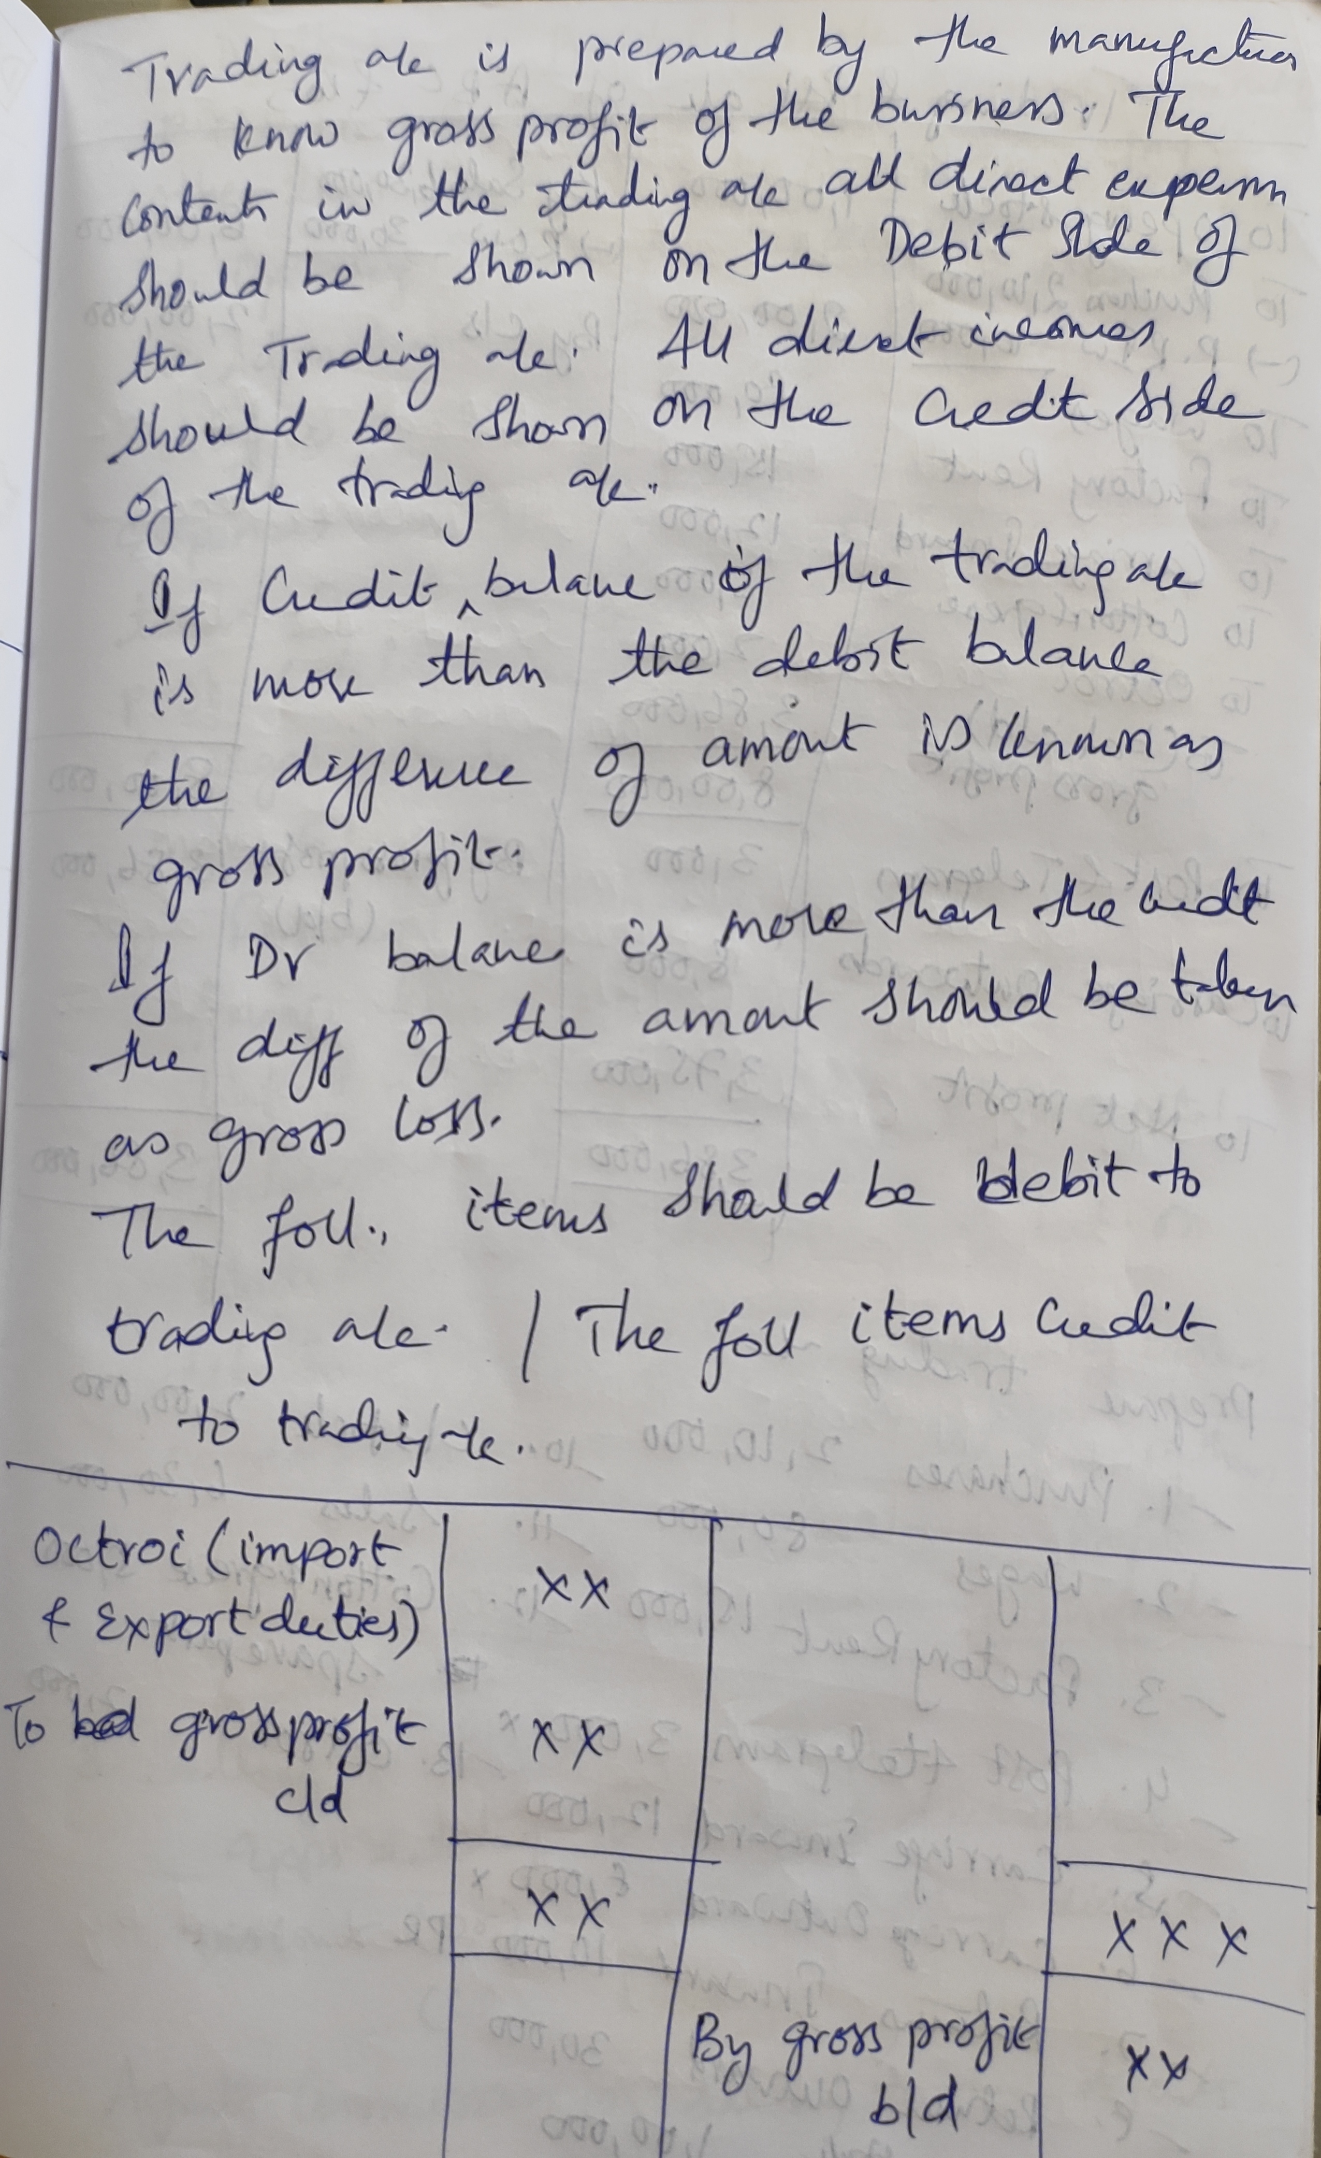

Slide 64
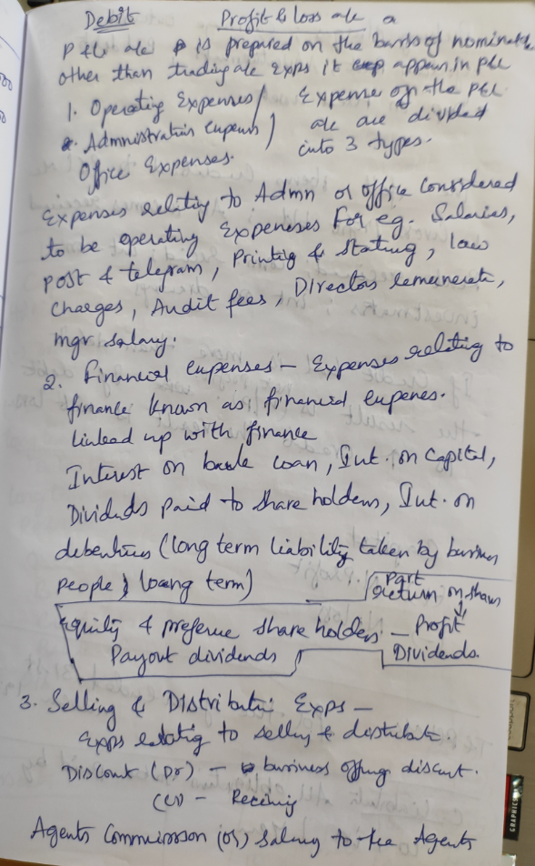
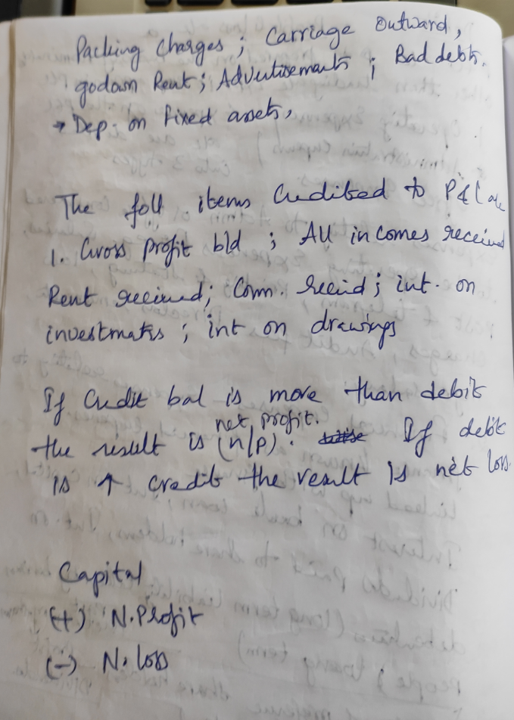

Slide 65
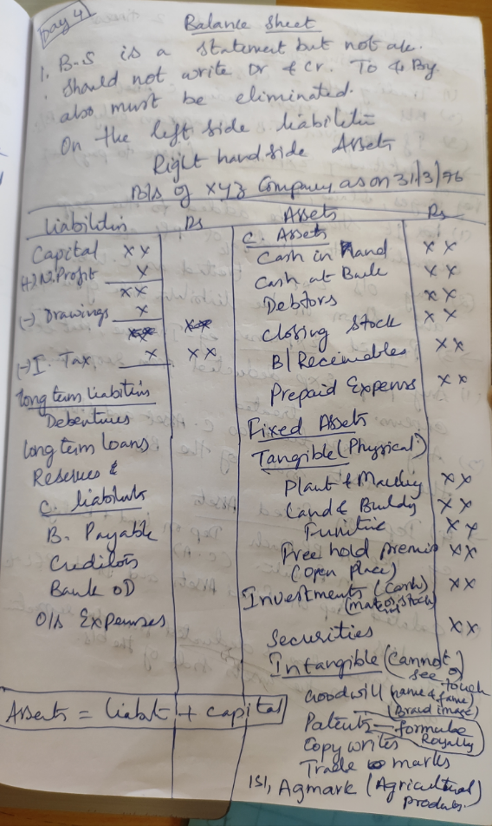

Slide 66
